Slide 1
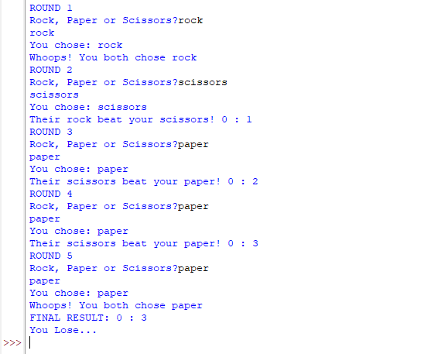
Python Portfolio Project
An Overview into the process

Slide 2





Project Summary
This project uses a python script to allow the user to play ‘rock, paper, scissors’ versus the computer over five rounds, using code that receives and understands the player input and compares it to the computer’s choice.
To recap, ‘Rock Paper Scissors’ is a game where two or more people guess either ‘rock’, ‘paper’ or ‘scissors’ at the same time. Scissors beats paper, rock beats scissors, and paper beats rock. If both players play the same object, the round ends in a tie.

Slide 3
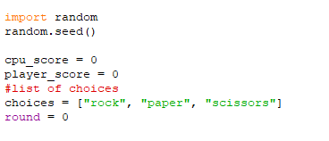
Initiation
The very first lines of code are import random and random.seed(), which tells the computer to use a random ‘seed’ for the game. Computers aren’t truly random, but by making up a seed it creates a sequence of ‘random’ decisions that differ each time the game is run. This matters because we are making the computer choose which of the three objects to play in a round. Four more variables are also declared here:
cpu_score: stores the computer’s score
player_score: stores the player’s store
round: stores the round of the game, which we’ll need to stop the game and declare a winner at the end.
choices: a list containing three strings that denote the three game objects. They are in this list as we can use code to make the computer decide from one of these ‘indexes’ to play in a round.

Slide 4
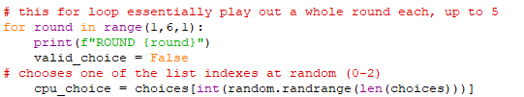
The Round Loop
This for loop contains all of the code used in a single round, and once the round is complete, returns to the start and increments our round variable, which is inserted as part of this loop.
It prints the value of the round as well as declaring a very important variable – valid_choice, which will be explored in the next slides.

Slide 5
The Round Loop
This is also the stage of the script where the computer chooses what object to play. While the code for this looks complex, what is nested inside choices[] ends up being either 0, 1 or 2, as the code inside it chooses a random number between 0 and the length of the array (3), and converts it into an integer. This integer conversion takes any number chosen and rounds it down to a full number, so we don’t need to worry about is being 2.94, for instance.

Slide 6
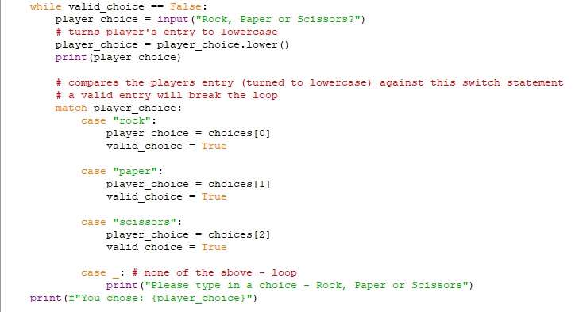


The While loop
This piece of code uses valid_choice to determine whether this code can continue beyond the loop. Inside this is an input function where the player can type in their object of choice, with a printed text instructing them to do so. .lower() is used to turn any text inputted into lowercase, so no matter how the player types in their choice (capitalisations concerned), it is processed into a format for the following match statement.

Slide 7
The While loop
A match statement is very useful here as it allows the code to make a selection based on the value of player_choice. While the same effect can be achieved using if statements, the match statement is a lot more efficient and easier to put together. Depending on the choice made, it makes the player’s choice equal its counterpart in the array and makes valid_choice equal ‘True’ to continue the code. If the player does not input a valid answer such as with ‘shoe’, this block of code repeats and the player is reminded to input a valid answer.

Slide 8
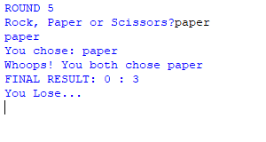
Final Comparison Logic
Here, the player and cpu’s choices are compared to each other in a sequence of if statements which affect the score of the game. Logical expressions (such as and, or) are used to bundle together identical winning and losing outcomes as the specifics of what object beat what are ascertained in the printed text.
After this is done, the entire for loop begins again until all rounds are exhausted. Once that is done, some simple if statements print out a final outcome and the game ends.

Slide 9
Things I could do differently
One aspect I struggled with was making tied games restart again without incurring the round counter. Without this, the game could theoretically end with both players at a score of zero.
I could also make the game function off of a while loop rather than a for loop, changing the game to a race to 5 points instead of having only 5 rounds. I could potentially give the player a choice on whether to execute code based on the 5 round rule or best of 5 rule.
I could also potentially introduce more countermeasures to prevent typos (unwanted spaces, inputs etc.) from causing invalid responses.

